Slide 1


HealthAI – Intelligent Healthcare Assistant
SmartInternz-IBM Cloud Internship Project
Presented by Bangaru Tejaswini
From NRI Institute of Technology

Slide 2



PROBLEM STATEMENT
Lack of instant medical support in remote areas
No immediate advice for common symptoms
Dependence on hospital visits for basic queries
Need for a simple AI-based health guide

Slide 3
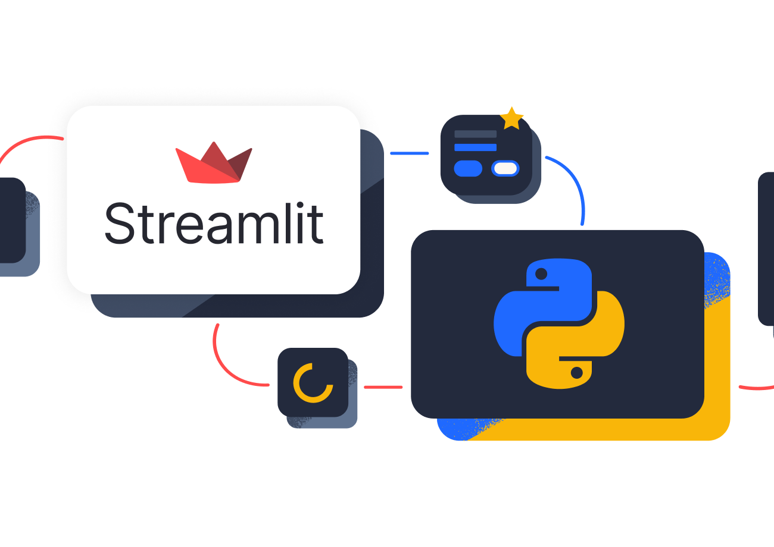
OBJECTIVES
To built a chatbot, predict conditions from symptoms, generate AI-based treatment suggestions, and create a sample web app using Streamlit.

Slide 4



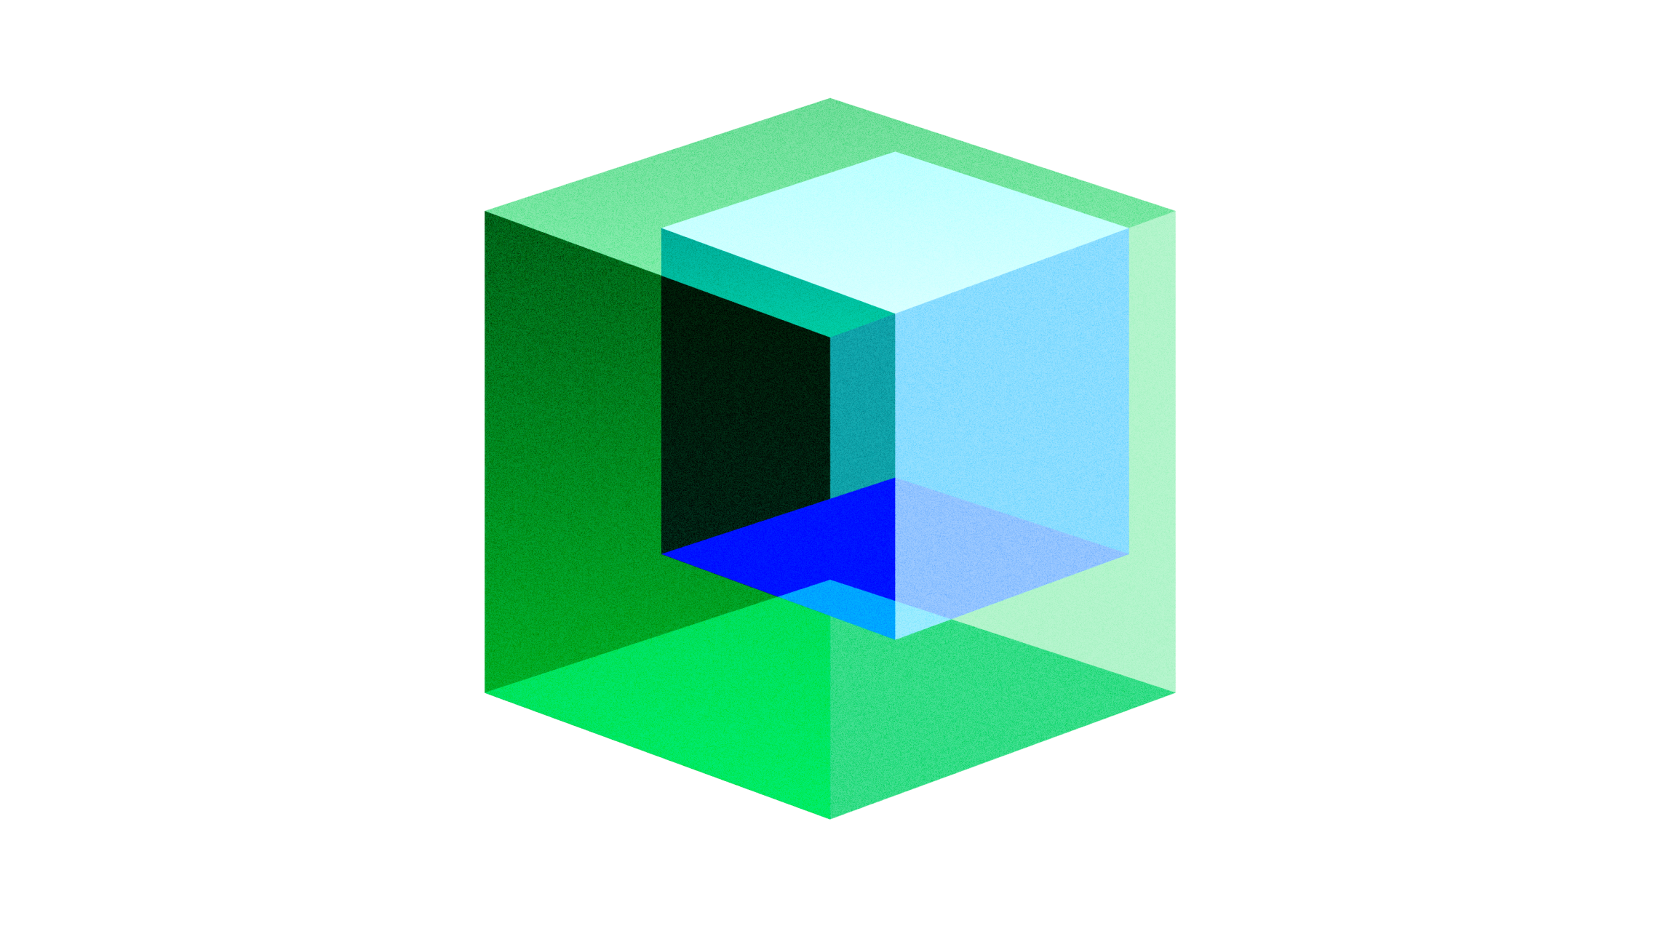


Technologies Used:
Python - Backend scripting
Streamlit and Pyngrok
Hugging Face API – AI model integration
IBM Granite 3.3B Instruct – Generative AI for chatbot
Google Colab – Execution environment, Build this application.
GitHub – Code versioning and hosting

Slide 5
System Architecture
User Input→
Streamlit →
Prompt →
Hugging Face API→
IBM Granite→
Output Display→

Slide 6
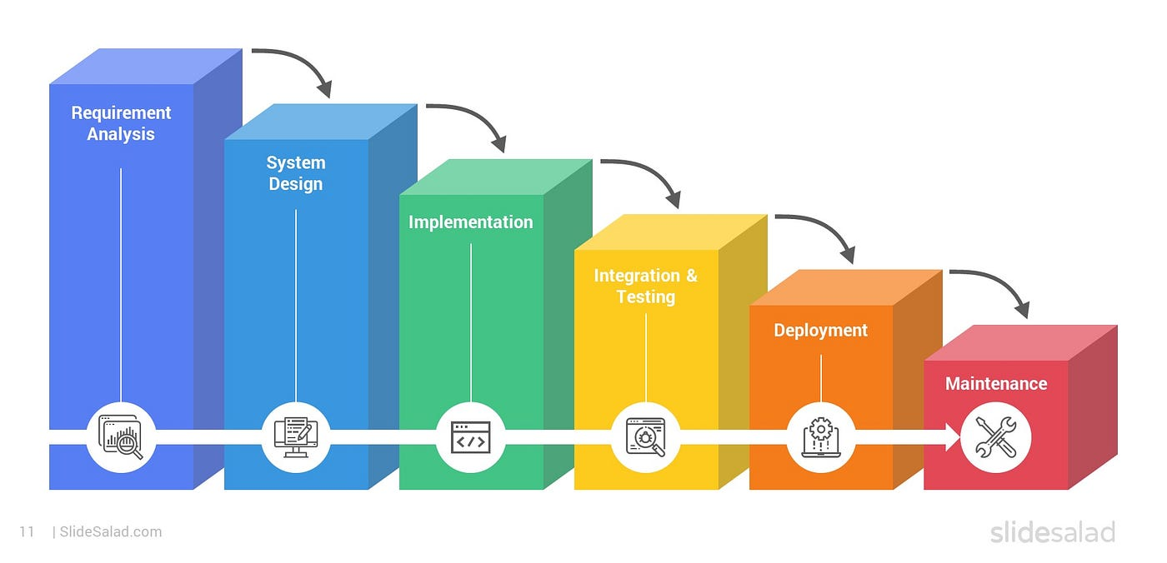
SDLC + Methodology
We followed SDLC phases: Requirement analysis, Design, implementation, Testing, and Deployment.

Slide 7
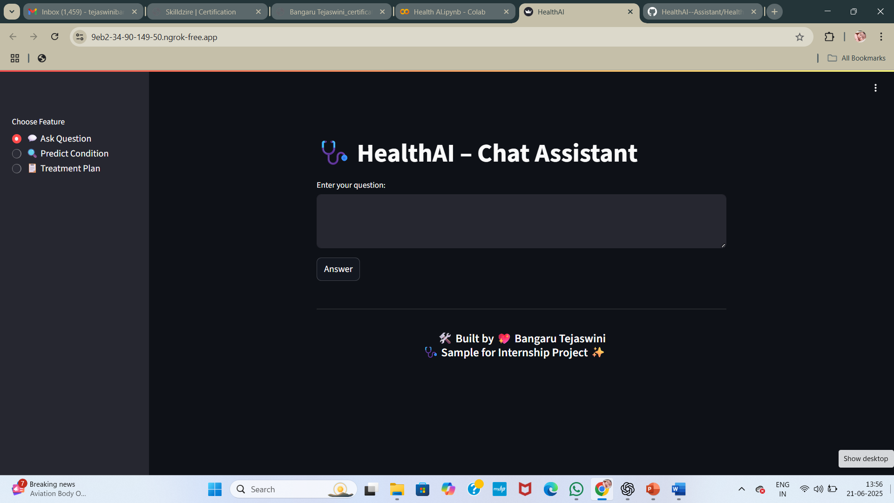
Key Features
Ask Health Question
Predict Condition
Generate Treatment Plan – all features are built using Streamlit UI.

Slide 8
Chat Assistant
User asks health-related question, and the AI gives a friendly and information answer.

Slide 9
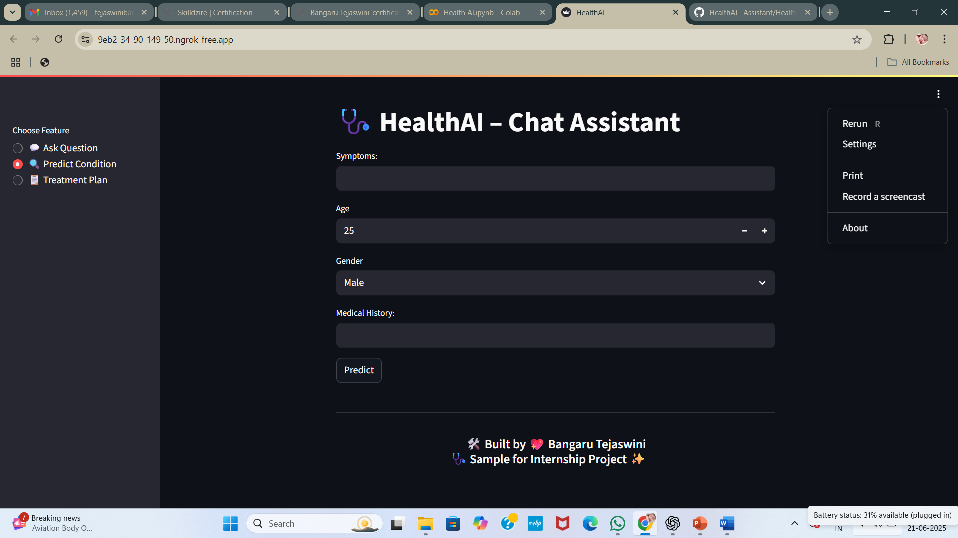
Predict Condition
After entering symptoms, the AI predicts the top 3 likely condition.

Slide 10
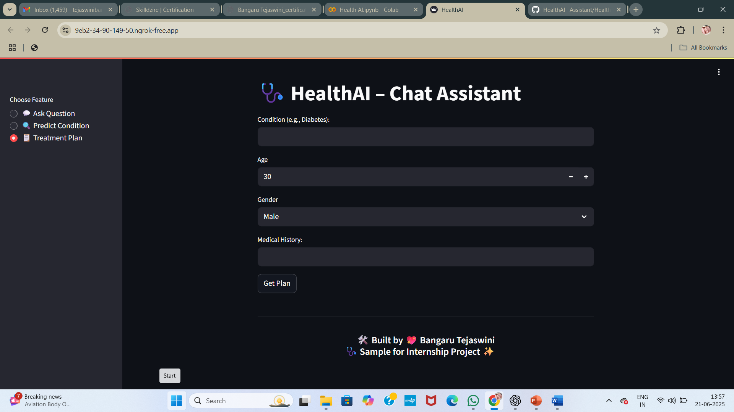
Treatment Plan
Based on the condition name, the AI suggests medicines, diet tips, and lifestyle changes.

Slide 11
Sample Output
For Diabetes, AI suggested Metformin, high-fiber diet, daily walking, and regular monitoring.

Slide 12
Advantages:
Available 24x7, accessible on mobile and desktop, easy for non-technical users, relible output from IBM Granite model.
Not a Doctor it’s just a basic symptoms handling only which needs internet access
No installation needed
Beginner-friendly & educational

Slide 13

Limitations
No voice support yet, dependent on API limits, not a replacement for a real doctor.

Slide 14

Future Scope
Add voice-based input, support Telugu and other languages, save user history, and link with hospital appointments.

Slide 15

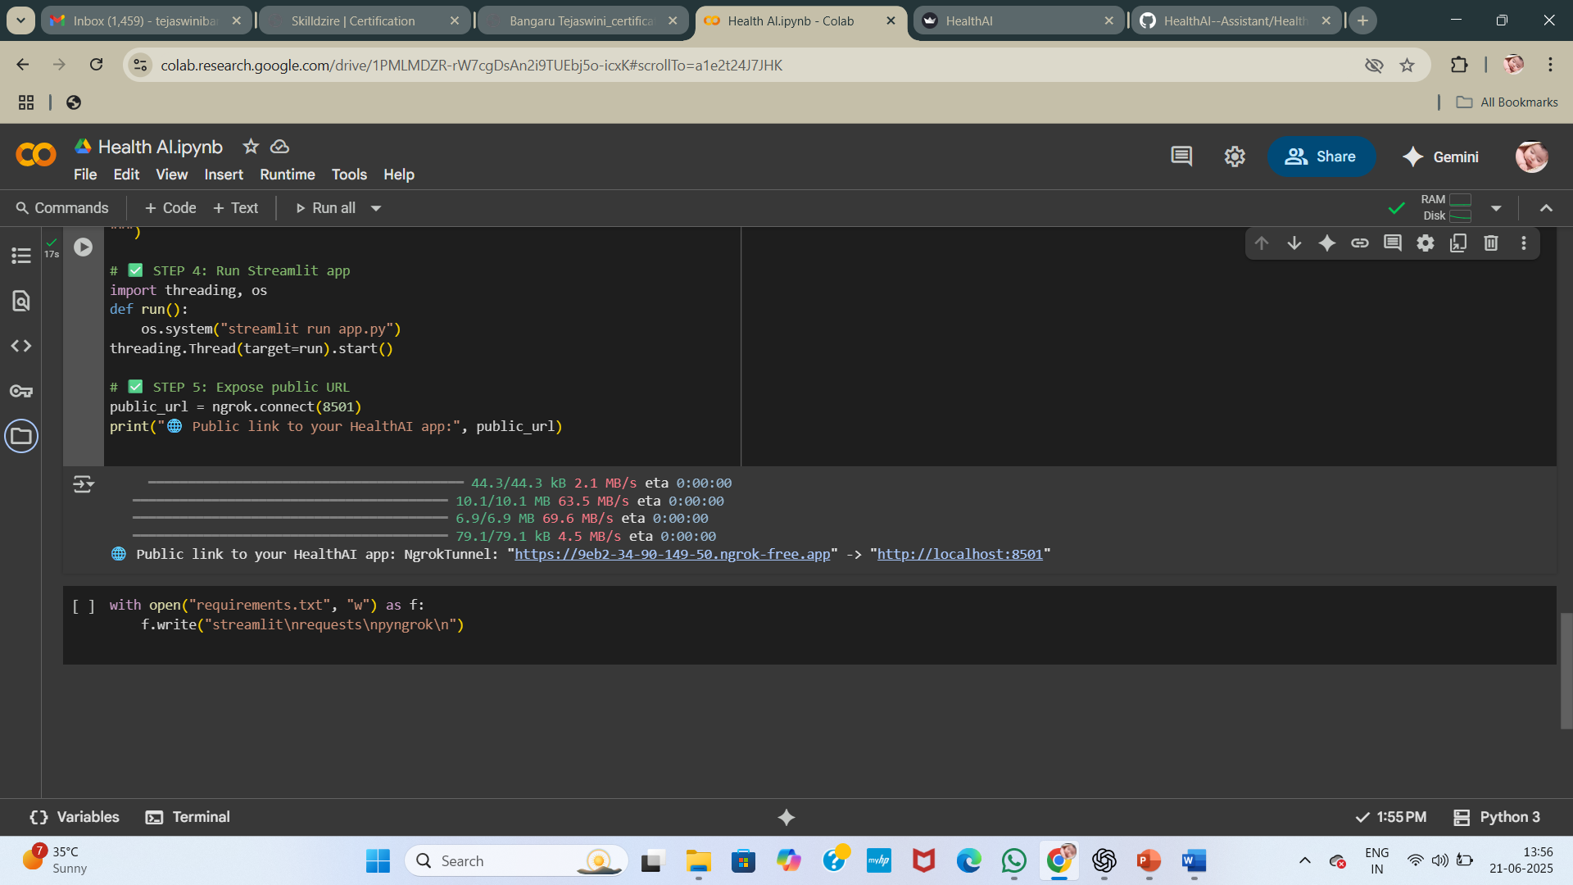
Live Demo + Credits
The app runs using Streamlit with a Public ngrok link. Footer shows “ Built by 💖 Bangaru Tejaswini ”

Slide 16

Thank You
Thanks for watching ! Please share your feedback on my Project
A project by Bangaru Tejaswini
GitHub:https://github.com/Tejaswini26308/HealthAI-Assistant

